Slide 1

Exploring Research Administration from Concept to Commercialization
Award Close-Outs
Presented by:
Cookie Kaur, Jill Aller & Rummy Miranda

Slide 2
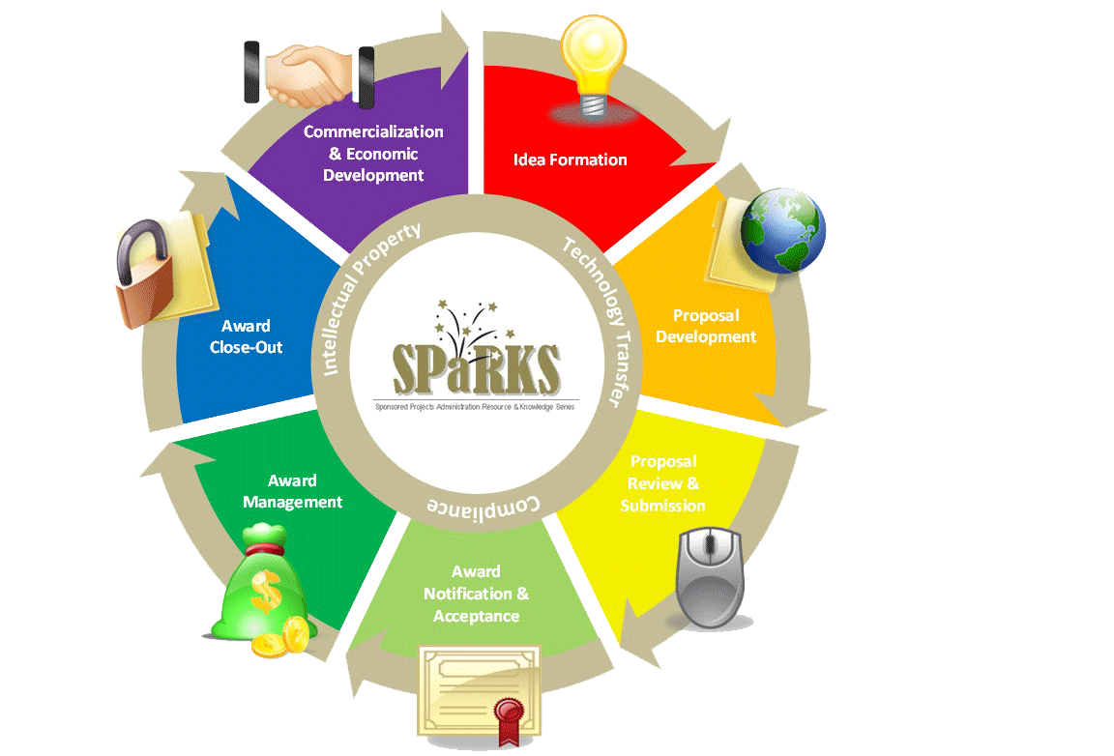
Exploring Research Administration from Concept to Commercialization

Slide 3
CLOSEOUTS!
Take a minute and write down your answers…
Why do we do closeouts?
What do you want to know about closeouts?
What’s a closeout?

Slide 4
GOAL & OBJECTIVES
GOAL: Help learners understand the overall closeout process and how each of their roles contributes to an “almost perfect” closeout.
OBJECTIVES: Learners will be able to:
Explain why it is necessary to close an award.
Describe what a project should look like when it is ready to be closed.
Evaluate a contract or grant’s readiness for closeout across six general areas.
AWARD CLOSE-OUT

Slide 5


Closeout requirements per OMB A-110
All reports due within 90 days of project end
All obligations liquidated within 90 days of project end
Sponsor will make prompt payments
Recipient will promptly refund unobligated cash
Sponsor shall make upward/downward adjustments after close-out docs are received
Recipient shall account for real and personal property
Sponsor may recover unallowable costs after an audit
AWARD CLOSE-OUT
Notes:
OMB A-110, Section D

Slide 6
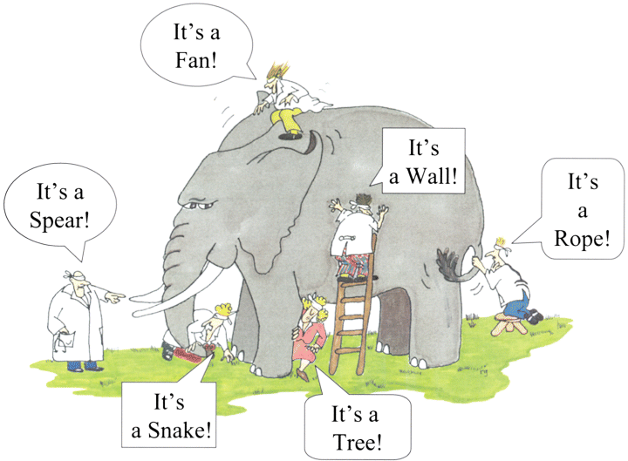

IT TAKES A VILLAGE …TO CLOSE A PROJECT

Slide 7
CLOSE-OUT OVERVIEW
Responsible Parties
Technical
(PI)
Administrative
(ORC)
Financial
(PI, Dept, F&A, ORC)
AWARD CLOSE-OUT

Slide 8
CLOSE-OUT OVERVIEW
Administrative |  | Financial
Deliverables/Progress Reports? - PI |  | Personnel still being paid?
Intellectual Property? |  | Encumbrances?
Equipment Disposition? |  | Cost Share met?
Subcontracts? Close them too. |  | Unallowable charges?
Agency Reports to submit? |  | Outstanding accts payable invoices?
 |  | Is project over/underspent?
 |  | Indirect/Overhead charged correctly?
 |  | All revenue received?
 |  | Balance to be transferred?
AWARD CLOSE-OUT

Slide 9
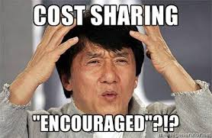
Compliant Budget Development
Take Care of the How Much!
Proposal Development
Budget Development
Proposal Submission
Compliance
Areas That Impact Compliance
Is the budget reasonable, allocable, allowable, and consistent?
Have cost accounting standards been followed?
Can we actually do the work for the price?
Is there mandatory, voluntary or hidden cost sharing?
Slide courtesy of Justo Torres’ presentation at SRA Southern Conference 2013
“Pre-Award Preparation for Post-Award Success.”

Slide 10
Compliant Compliance – wait, what?
Repeat and Repeat Again!
Proposal Development
Budget Development
Proposal Submission
Compliance
The Impact of Compliance
A technically feasible project.
A realistic, allowable budget.
A responsible PI.
An effective project team.
A clear indication of roles and expectations.
A standard by which to judge the conduct of the project.
Slide courtesy of Justo Torres’ presentation at SRA Southern Conference 2013
“Pre-Award Preparation for Post-Award Success.”

Slide 11
PRE-CLOSEOUT CONSIDERATIONS
90 Days before a project ends
Technical Reports and Deliverables
Expenditure and Revenue
Invoicing
Equipment Vesting
Plans for Personnel
To Extend or Not to Extend…
Other Recurring Charges
THINGS TO REVIEW
AWARD CLOSE-OUT

Slide 12
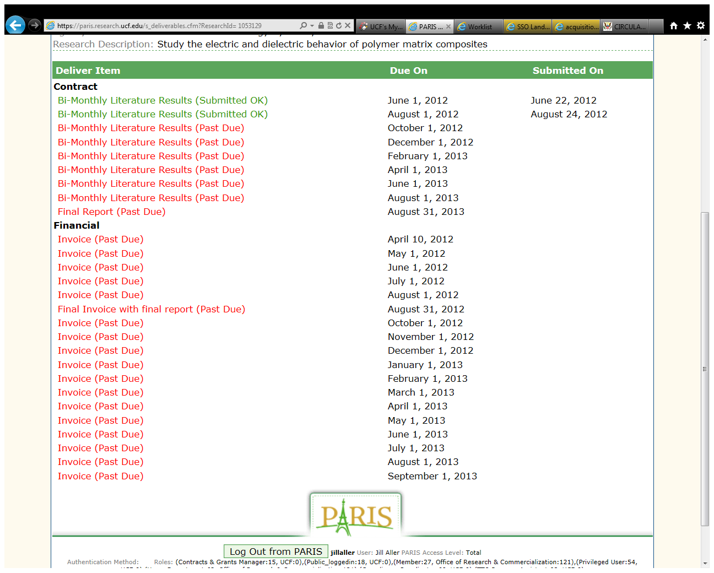
PRE-CLOSEOUT CONSIDERATIONS
Reporting Requirements – What does ARGIS say?
AWARD CLOSE-OUT

Slide 13

PRE-CLOSEOUT CONSIDERATIONS
Expenditure Review
Expenditures should be monitored at all times, but…
Corrections or adjustments may be required
Are All Costs Reasonable, Allowable, Allocable, and Appropriate?
Is the Project Over or Under Spent?
Are There any Costs That Do Not Belong?
Do I have More or Less Revenue than Expected?
AWARD CLOSE-OUT

Slide 14

CLOSEOUT PROCESS
Administrative - Deliverables
Technical Review and Certification
Ensures that all technical work has been performed as specified in the award document and is acceptable to the sponsor
Were all deliverables submitted?
Final Report
SF 298
DD 254
Reports all technical accomplishments
Certification that final technical report is submitted
Certification of disposition of classified information
AWARD CLOSE-OUT

Slide 15
CLOSEOUT PROCESS
Administrative – Intellectual Property
Examples of forms below. Forms and requirements may differ from Sponsor to Sponsor.
DD 254
DD882
Certification of disposition of classified information
Certification of Invention
AWARD CLOSE-OUT

Slide 16
CLOSEOUT PROCESS
Administrative - Equipment
Some questions to consider:
Was equipment purchased on the project?
Did the government furnish equipment for the project? (GFE)
Where is the equipment?
Who owns the equipment?
  If not UCF, do we want it?- Request vesting rights
AWARD CLOSE-OUT

Slide 17
CLOSEOUT PROCESS
Administrative – Equipment cont’d
Equipment/Property Review and Certification
Ensures that all Government-Furnished Property (GFP) or Contractor-Acquired property is properly managed
Final Inventory
SF 428 or
NASA 1018
PeopleSoft query to investigate purchased and tagged equipment
Certification status and vesting of property
Annual Property Audits & Self Assessment
Annual assessments of property management
Check Award for equipment <$5,000
ONR
NASA
Self-assessment
AWARD CLOSE-OUT

Slide 18
CLOSEOUT PROCESS
Subcontracts Close-out
When subcontracting, it is our responsibility to require any subcontractors to report in the same manner and fashion as is required of us
Build timetable for subcontractors’ reports that allows for timely submission to the prime
Method of payment should be appropriate to monitor restrictions flowed down from prime
AWARD CLOSE-OUT

Slide 19
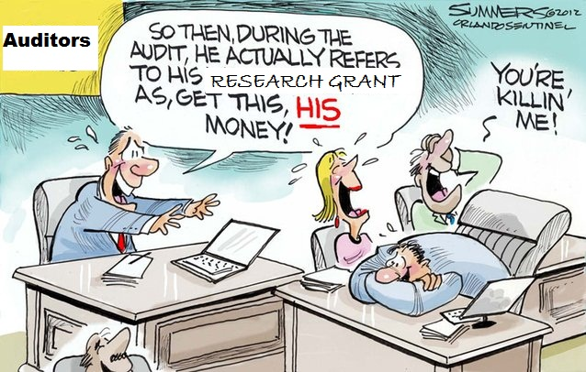
CLOSEOUT - FINANCIAL
AWARD CLOSE-OUT

Slide 20
CLOSEOUT - FINANCIAL
Financial
Some questions to consider:
Are all costs booked to this project and are they appropriate?
Have all recurring costs been cancelled? – payroll, telephone, etc.
Has all F&A been allocated?
Have all costs been invoiced?
Has all revenue been received?
Was all cost share met?
AWARD CLOSE-OUT

Slide 21
CLOSEOUT - FINANCIAL
Financial Review and Certification
Ensure that all costs are booked, allowable, allocable, consistent, and reasonable
Ensure that all recurring charges have been cancelled and all obligations paid
Final Invoice
SF 425 or Final Voucher
Contractor’s Release
All Costs are invoiced
Reconcile cash and expenditures
Certification to release sponsor from further financial obligation
Contractor’s Assignment
Assign any rebate to sponsor
AWARD CLOSE-OUT

Slide 22

CLOSEOUT - FINANCIAL
What happens to remaining balances on a project?
Cost Reimbursable
Fixed Price
Methods of Payment
defined in contract

Slide 23
CLOSEOUT - FINANCIAL
REFUNDS
Should be the exception rather than the rule
Only applies to cost-reimbursable projects when:
  Cash has been drawn or invoiced without actual cost basis
  Costs have been transferred off the project after being invoiced and paid
  Advanced payment has been made, but not utilized
  Cost has been deemed unallowable
AWARD CLOSE-OUT

Slide 24


Slide 25
What closeout can’t do -
The closeout of an award does not affect:
Sponsor’s right to disallow/recover costs from later audit
Recipient’s obligation to return any funds due as a result of later refunds, corrections, etc.
Audit requirements
Property management requirements
Record Retention
AWARD CLOSE-OUT

Slide 26

Think about it…
Now that you know that everyone plays a role in ensuring a proper closeout, what are two things you can do in your job that help to ensure a successful closeout?
Take a minute to write your answer and then discuss.
What can I do?

Slide 27

QUESTIONS or COMMENTS?

Slide 28

THANKS FOR JOINING US!
See you at the next session:
Export Compliance & Facility Security
October 23, 2013
10:00am-12:00Pm
ORC 2nd floor large (#211)

